Slide 1
School of Geography and Geology
McMaster University
Introduction to Spatial Statistics
(510-654)
PART IV:
Spatially Continuous Data

Slide 2
Plan for Today
Part IV: Spatially continuous data
Review session: Questions and answers

Slide 3
This session:
Part IV: Spatially Continuous Data
  Definitions
  Visualization
  Exploration
    First Order Properties
    Moving Averages
    Kernel Estimation
    Tesselation Methods
  Second Order Properties
  Covariogram and Variogram

Slide 4
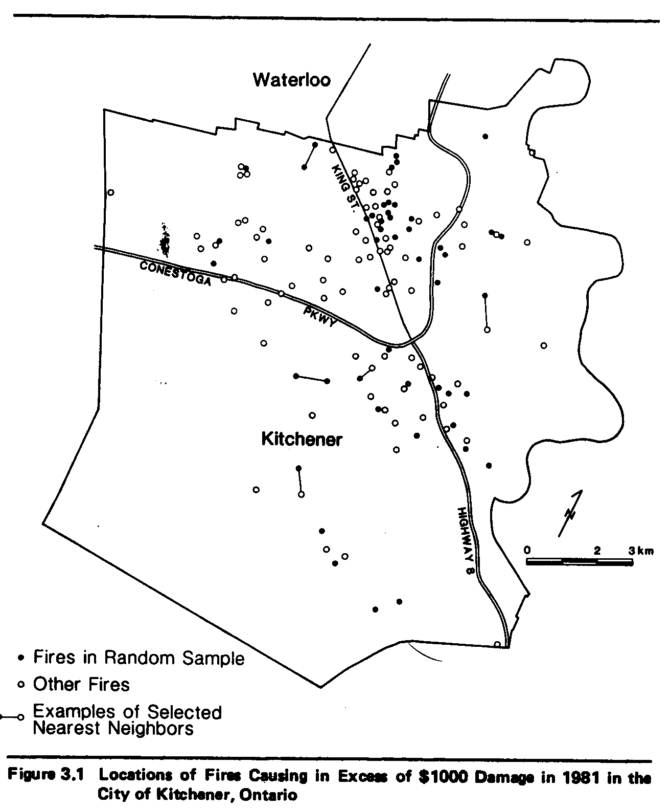
The difference between point patterns and spatially continuous data
Location of fires in Kitchener, Ontario

Slide 5
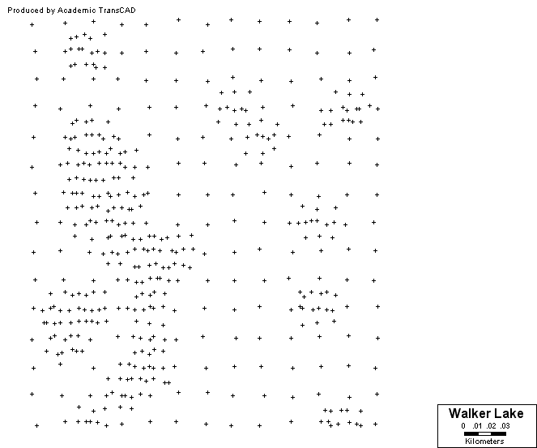
The difference between point patterns and spatially continuous data
Concentration of a contaminant in ppm

Slide 6
The difference between spatially continuous data and area data
Time series
Temperature
Interest Rates
Temperature
Interest rates
Time
Time

Slide 7
Scale of Analysis

Slide 8
Examples of Applications
Rainfall
Temperature
Groundwater levels
Radon gas
PCBs
Climate measures
Geochemical data

Slide 9
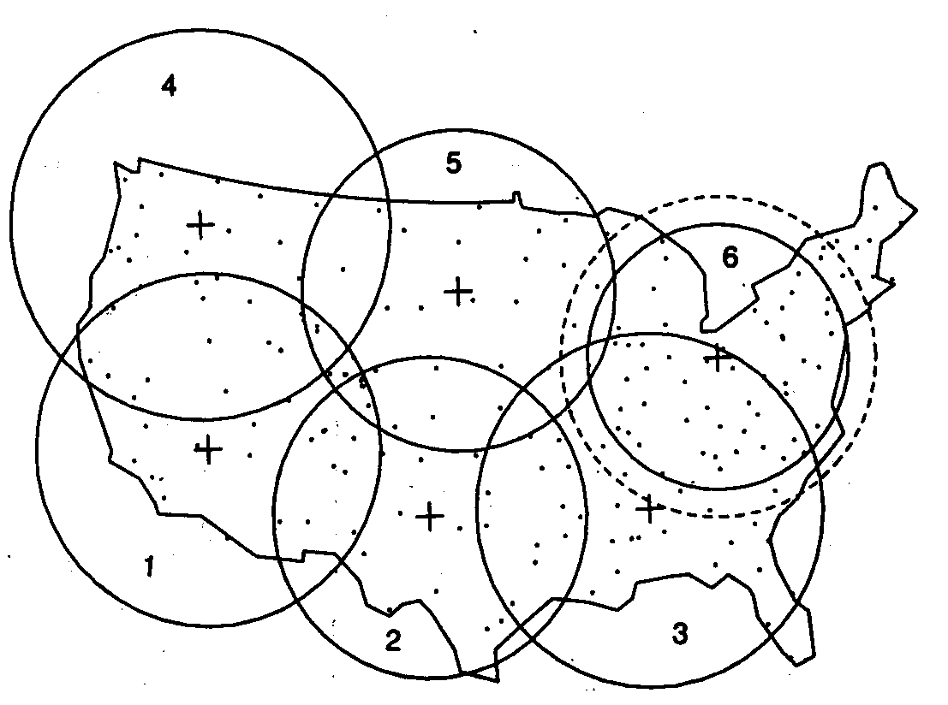
US NADP/NTN*: Stations in the US
*National Atmospheric Deposition Program/
National Trends Network

Slide 10
US NADP/NTN*: Stations in the US
Damage to environments from acid rain
Forest effects: die-off of trees at high elevations
Long term effects on the growth of commercial stands

Slide 11
Goals of Applications
The description of important features
Estimation of an average value over large areas
The estimation of an average value over small areas
Estimation of an unknown value at a particular location
(first order and second order effects)

Slide 12
Goals of Applications: PP
The description of important features
The identification of clustered, random or regular patterns
(first order and second order effects)

Slide 13
Spatially Continuous Data
Visualization
Exploration

Slide 14
Definitions
Region
Location
Attributes
Observation
First order effects
Second order effects

Slide 15
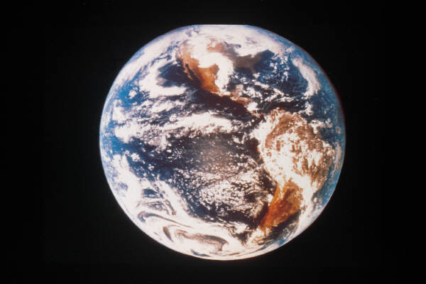
Definitions: Region
Region (R) – Specific area over the surface of the earth that is of interest

Slide 16
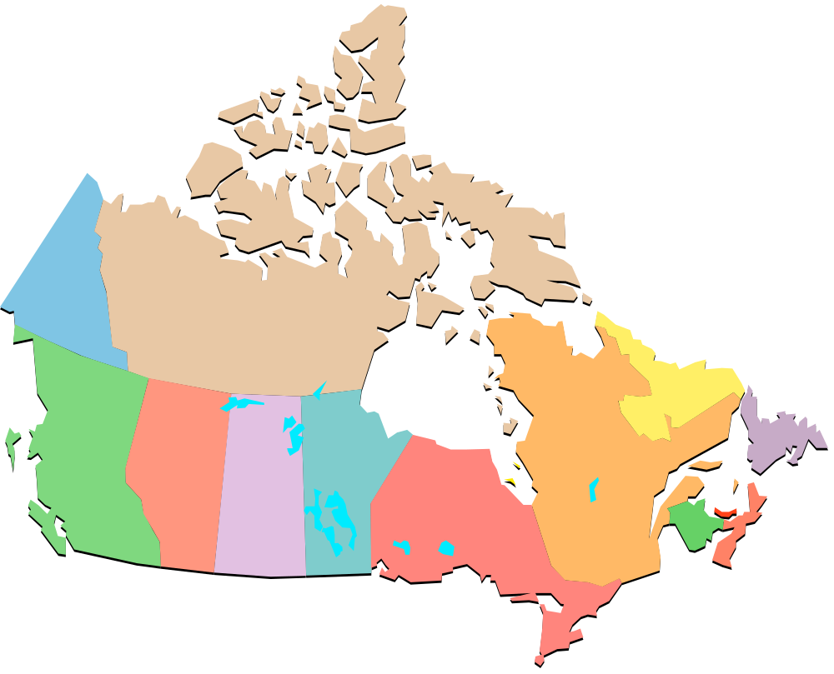
Definitions: Region

Slide 17
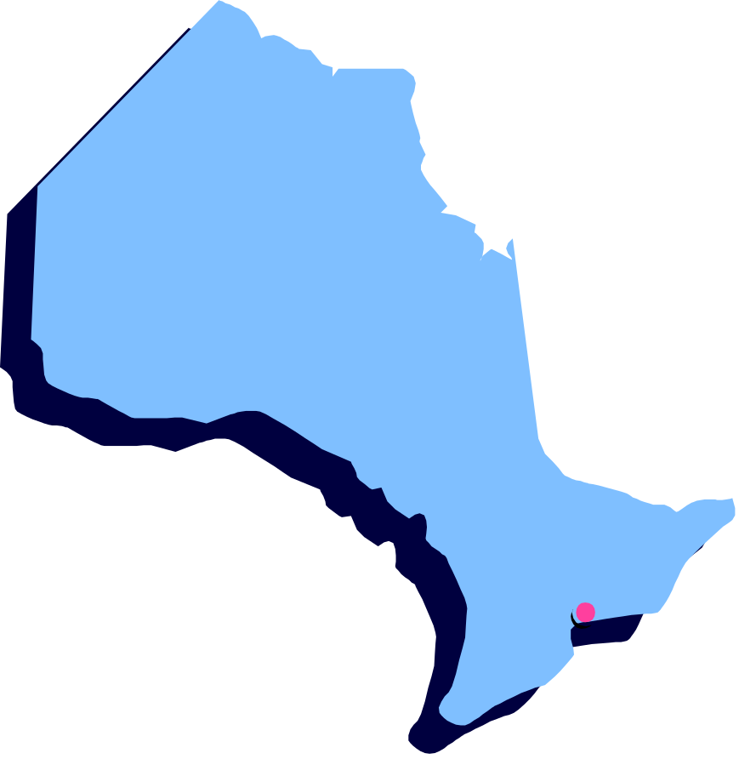
Definitions: Region

Slide 18

Definitions: Region

Slide 19
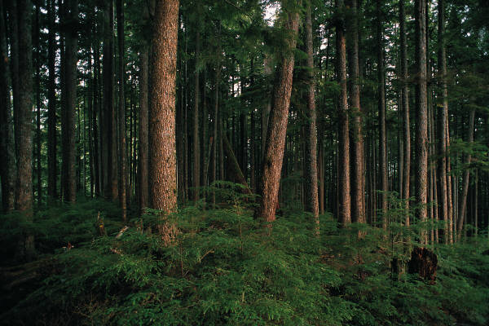
Definitions: Region

Slide 20
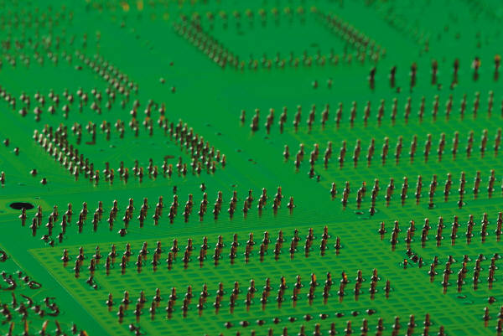
Definitions: Region

Slide 21
Definitions: Location
An arbitrary point in region R
s=(s1,s2)
“x” and “y” coordinates

Slide 22
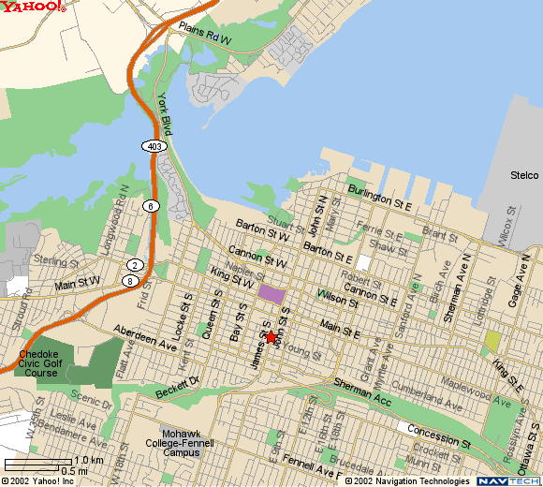
Definitions: Attribute
A characteristic of interest about a location

Slide 23
Definitions: Observation
A location for which one or more attributes have been measured
Y=(y₁,y₂,…,y_{n})

Slide 24
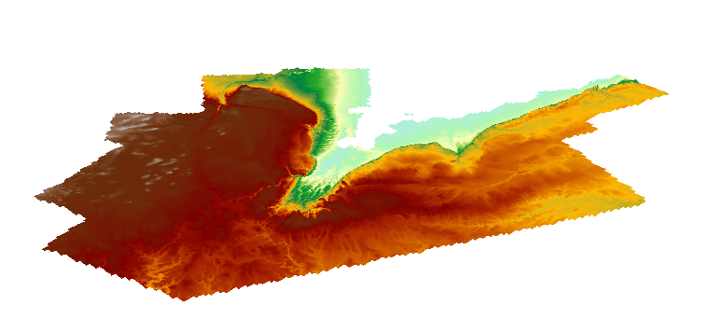
Definitions: First Order Effects
Large scale variation

Slide 25
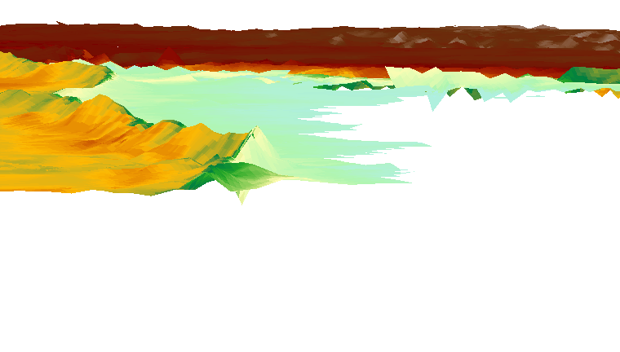
Definitions: Second Order Effects
Small scale variation

Slide 26
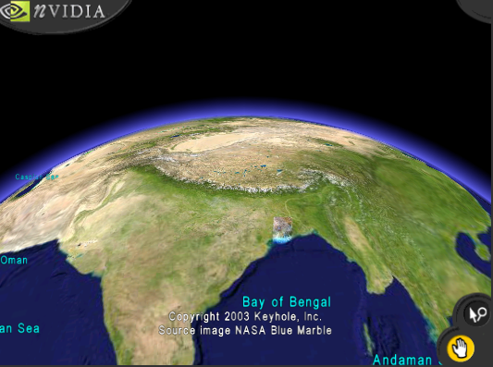
Definitions: Large Scale Variation

Slide 27
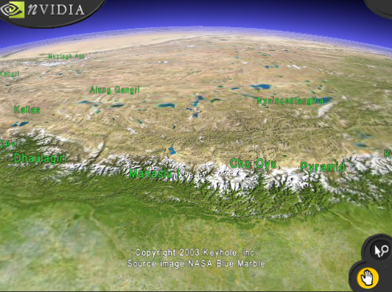

Slide 28
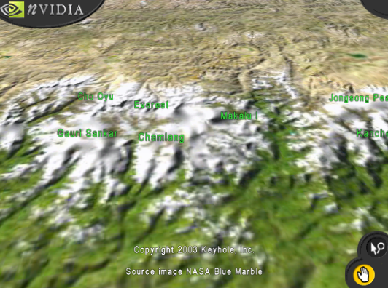
Definitions: Small Scale Variation

Slide 29
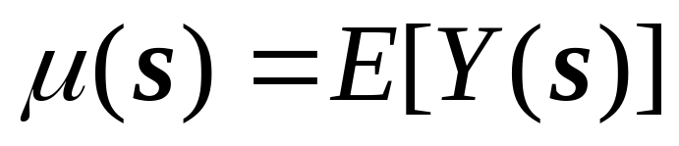
First Order Effects
Expected value of Y at s
(systematic, deterministic)

Slide 30
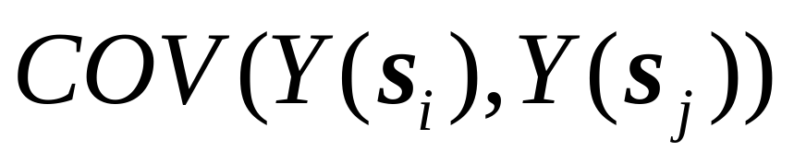
Second Order Effects
Covariance between of Y(s_{i}) and Y(s_{j})
(systematic, deterministic? random, unpredictable?)

Slide 31
Visualizing Spatially Continuous Data
Symbol maps
Proportional symbol maps
Indicator maps

Slide 32

Visualization: Symbol Map
(Walker Lake)
0
5

Slide 33
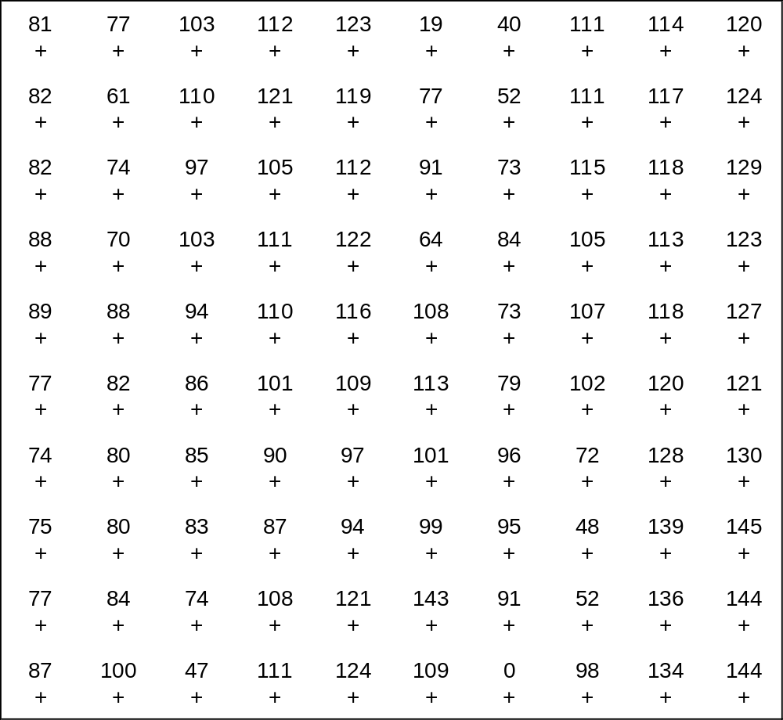
Visualization: Symbol map w/labels

Slide 34

Visualization: Indicator Maps
V<15 ppm
V≥15 ppm

Slide 35

Visualization: Indicator Maps
V<30 ppm
V≥30 ppm

Slide 36

Visualization: Indicator Maps
V<45 ppm
V≥45 ppm

Slide 37
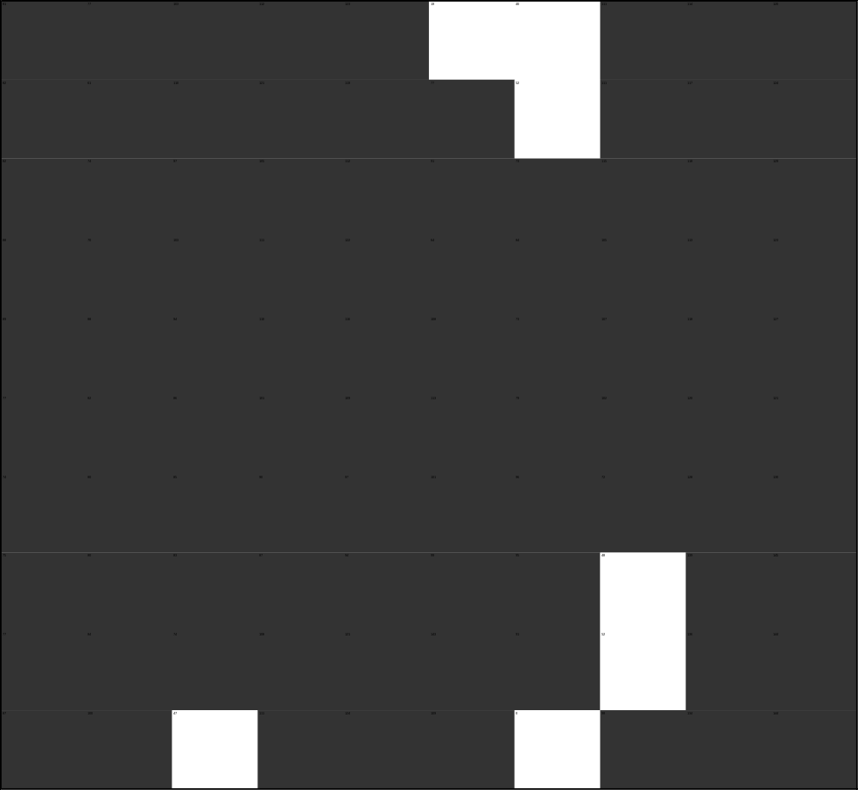
Visualization: Indicator Maps
V<60 ppm
V≥60 ppm

Slide 38

Visualization: Indicator Maps
V<75 ppm
V≥75 ppm

Slide 39
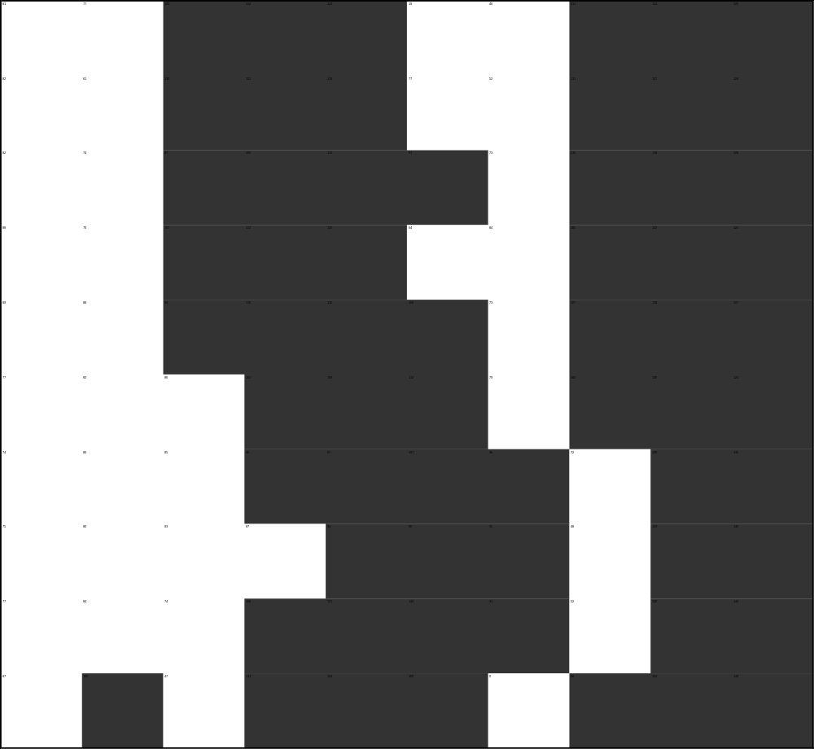
Visualization: Indicator Maps
V<90 ppm
V≥90 ppm

Slide 40

Visualization: Indicator Maps
V<105 ppm
V≥105 ppm

Slide 41
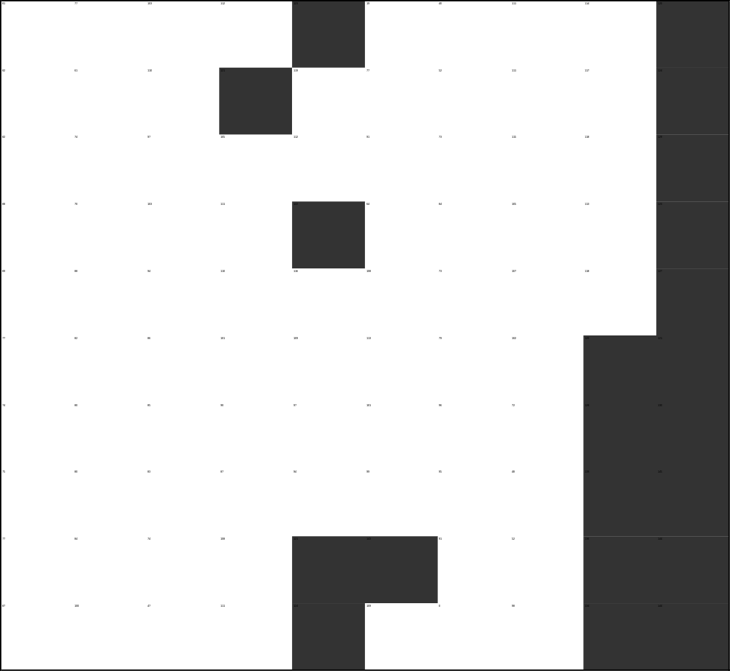
Visualization: Indicator Maps
V<120 ppm
V≥120 ppm

Slide 42

Visualization: Indicator Maps
V<135 ppm
V≥135 ppm

Slide 43
Visualization: Indicator Maps
V<15 ppm V≥15 ppm
V<30 ppm V≥30 ppm
V<45 ppm V≥45 ppm
V<60 ppm V≥60 ppm
V<75 ppm V≥75 ppm
V<90 ppm V≥90 ppm
V<105 ppm V≥105 ppm
V<120 ppm V≥120 ppm
V<135 ppm V≥135 ppm

Slide 44
Visualization: Grayscale map

Slide 45
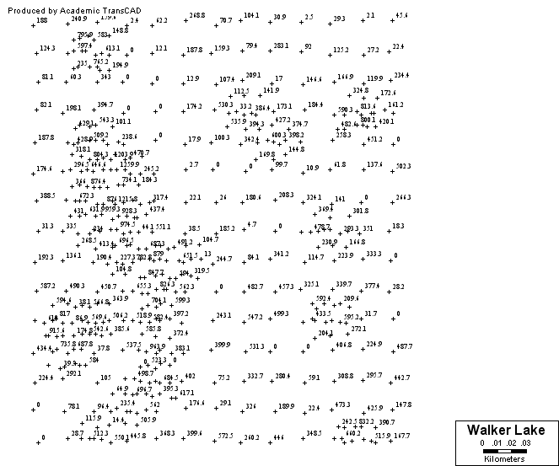
Visualization: Symbol Map w/labels

Slide 46
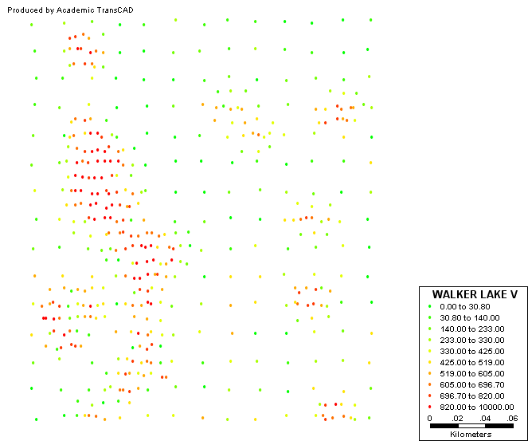
Visualization: Symbol Map w/colors

Slide 47
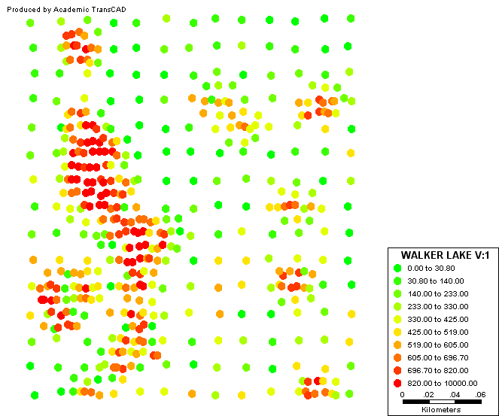
Visualization: Symbol Map w/colors

Slide 48
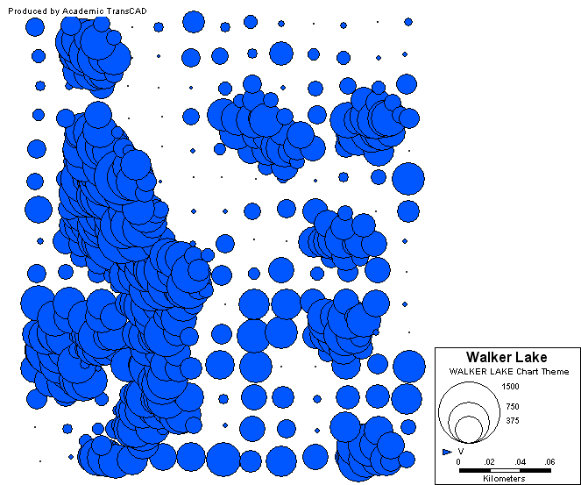
Visualization: Proportional Symbol Map

Slide 49
Visualization
Irregularly spaced observations
  Indicator Maps?
  Grayscale maps?

Slide 50
Exploration: Average (Large Area)

Slide 51
Exploration: Averages at Different Scales
n observations
1 observation

Slide 52
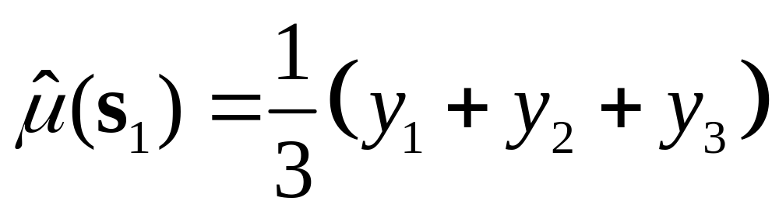
Exploration: Moving Averages
Three-point spatial moving average
2
1
3

Slide 53
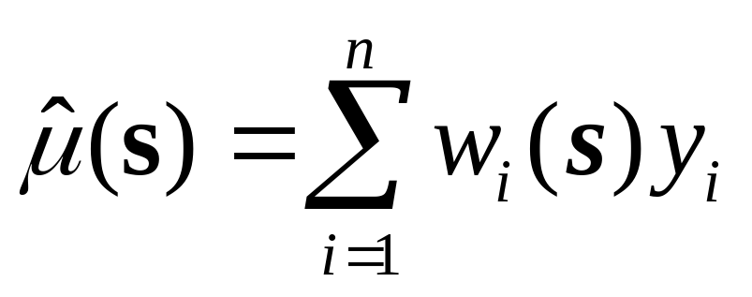
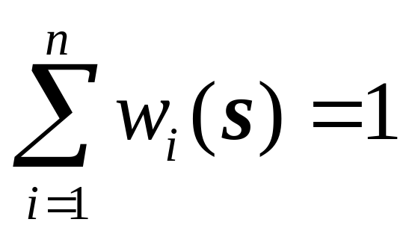
Exploration: Moving Averages

Slide 54
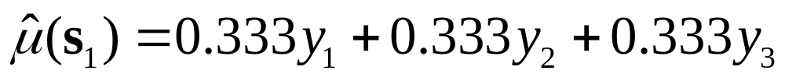
Exploration: Moving Averages

Slide 55
Exploration: Moving Averages

Slide 56
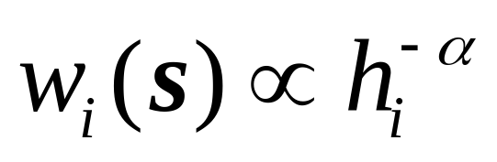
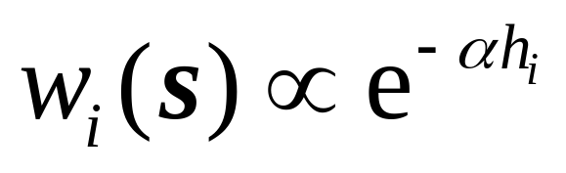
Exploration: Moving Averages
M

Slide 57
Exploration: Kernel Estimation
Kernel function
s
s_{i}
h_{i}
τ

Slide 58
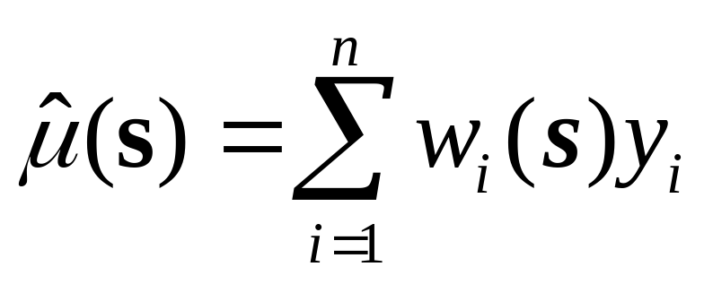
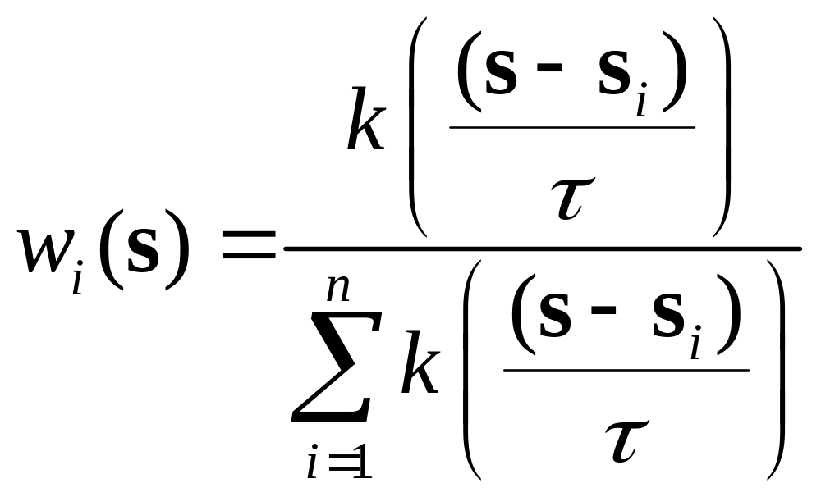
Exploration: Kernel Estimation

Slide 59
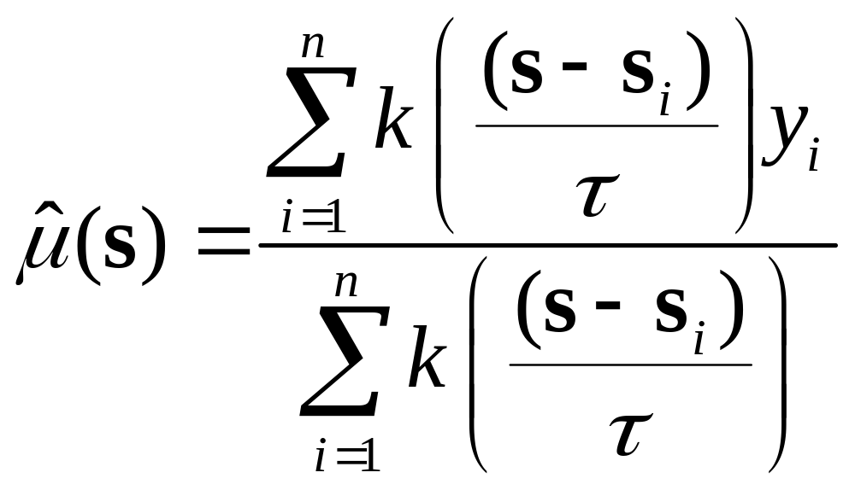
Exploration: Kernel Estimation

Slide 60
Exploration: Tessellations
The objective is to produce “tiles”

Slide 61
Tessellations: Delaunay Triangulation
2
Triangulated Irregular Network (TIN)
Triangles are as close to equilateral as possible
1
3
6
4
5

Slide 62
Tessellations: Voronoi Polygons
2
Areas of Influence
1
3
6
4
5

Slide 63
Tessellations: Delaunay Triangulation
2
1
3
6
4
5

Slide 64
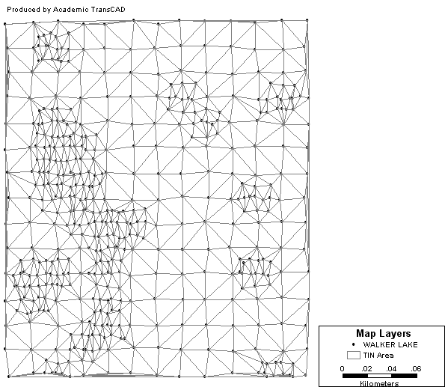
Exploration: Delaunay Triangulation

Slide 65
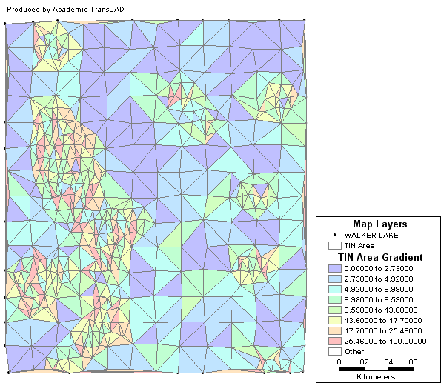
Exploration: Delaunay Triangulation

Slide 66
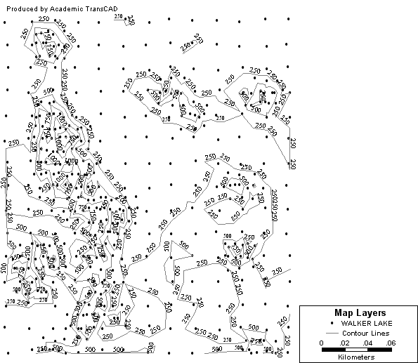
Exploration: Contours

Slide 67
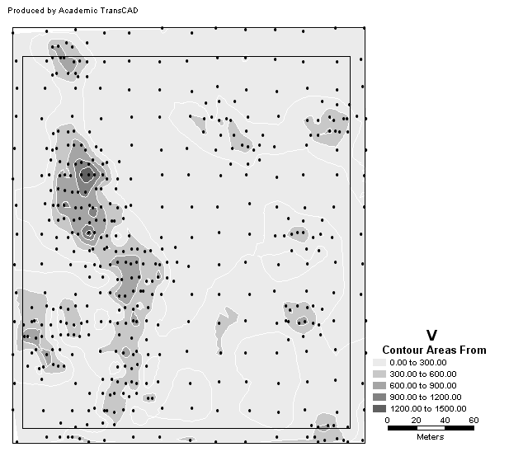
Exploration: Contour Areas

Slide 68
Next…
Second order effects
Covariogram and variogram

